Slide 1

R markdown Tutorial

Slide 2
Learning objectives
What is R Markdown?
Why learn R Markdown?
Writing basic R Markdown documents
Knitting R Markdown documents to create html/pdf documents
Publishing documents with Rpub

Slide 3
What is R Markdown?
A software tool for creating professional documents from R code
It’s free
It runs on R Studio
You have to know a bit of R to use it
You can re-use your scripts on similar data and your workflow can be checked more easily

Slide 4
Why learn/use R Markdown?
Seems like lots of extra effort!
Benefits:
1 – Makes your work more reproducible
2 – Makes communicating your results easier
3 – Helps writing code, using the philosophy of “Literate Programming”

Slide 5
What is literate programming?
Traditional workflows consist of two separate stages:
1 – Writing code and running scripts to perform your analysis (e.g. in Python, R, or any other setting)
2 – Writing the results of your analysis (e.g. word documents, powerpoint, etc.)

Slide 6
What is literate programming?
Literate programming is the idea of JOINING these two stages together, so that our code for analysis AND our documentation about the methods/results are all in the same document
R Markdown enables us to do this!

Slide 7
What is literate programming?
Again, why do you care about literate programming?
1 – Helps you to focus on what you are doing – writing code and documenting results (i.e. stops you worrying about formatting)
2 – Allows you to keep track of complex analyses
3 – Helps with Reproducible Research!

Slide 8
R Markdown Basics
Markdown is a simple coding language
You write in plain text
There are only a small number of formatting options
R Markdown is the integration of Markdown with the R environment

Slide 9
R Markdown Basics
An R Markdown document consists of:
Code chunks – where you write and execute R code for your analyses
Plain text – forms the explanatory section of our document (the end-product)
Simple right…

Slide 10
R Markdown - example
I will now run you through an example of using R Markdown
In fact, at the end of this presentation you can download the example R Markdown document that is used for this tutorial, and explore with it yourself

Slide 11
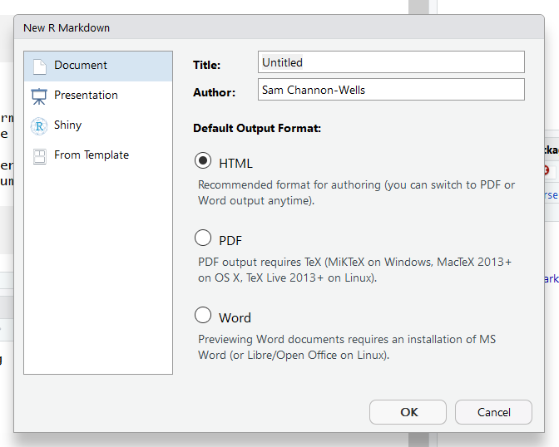
R Markdown - example
Create a new R Markdown document from R Studio by selecting “File” -> “New File” -> “R Markdown”
Enter your own title
Advanced options (not covered here – but feel free to explore!)

Slide 12
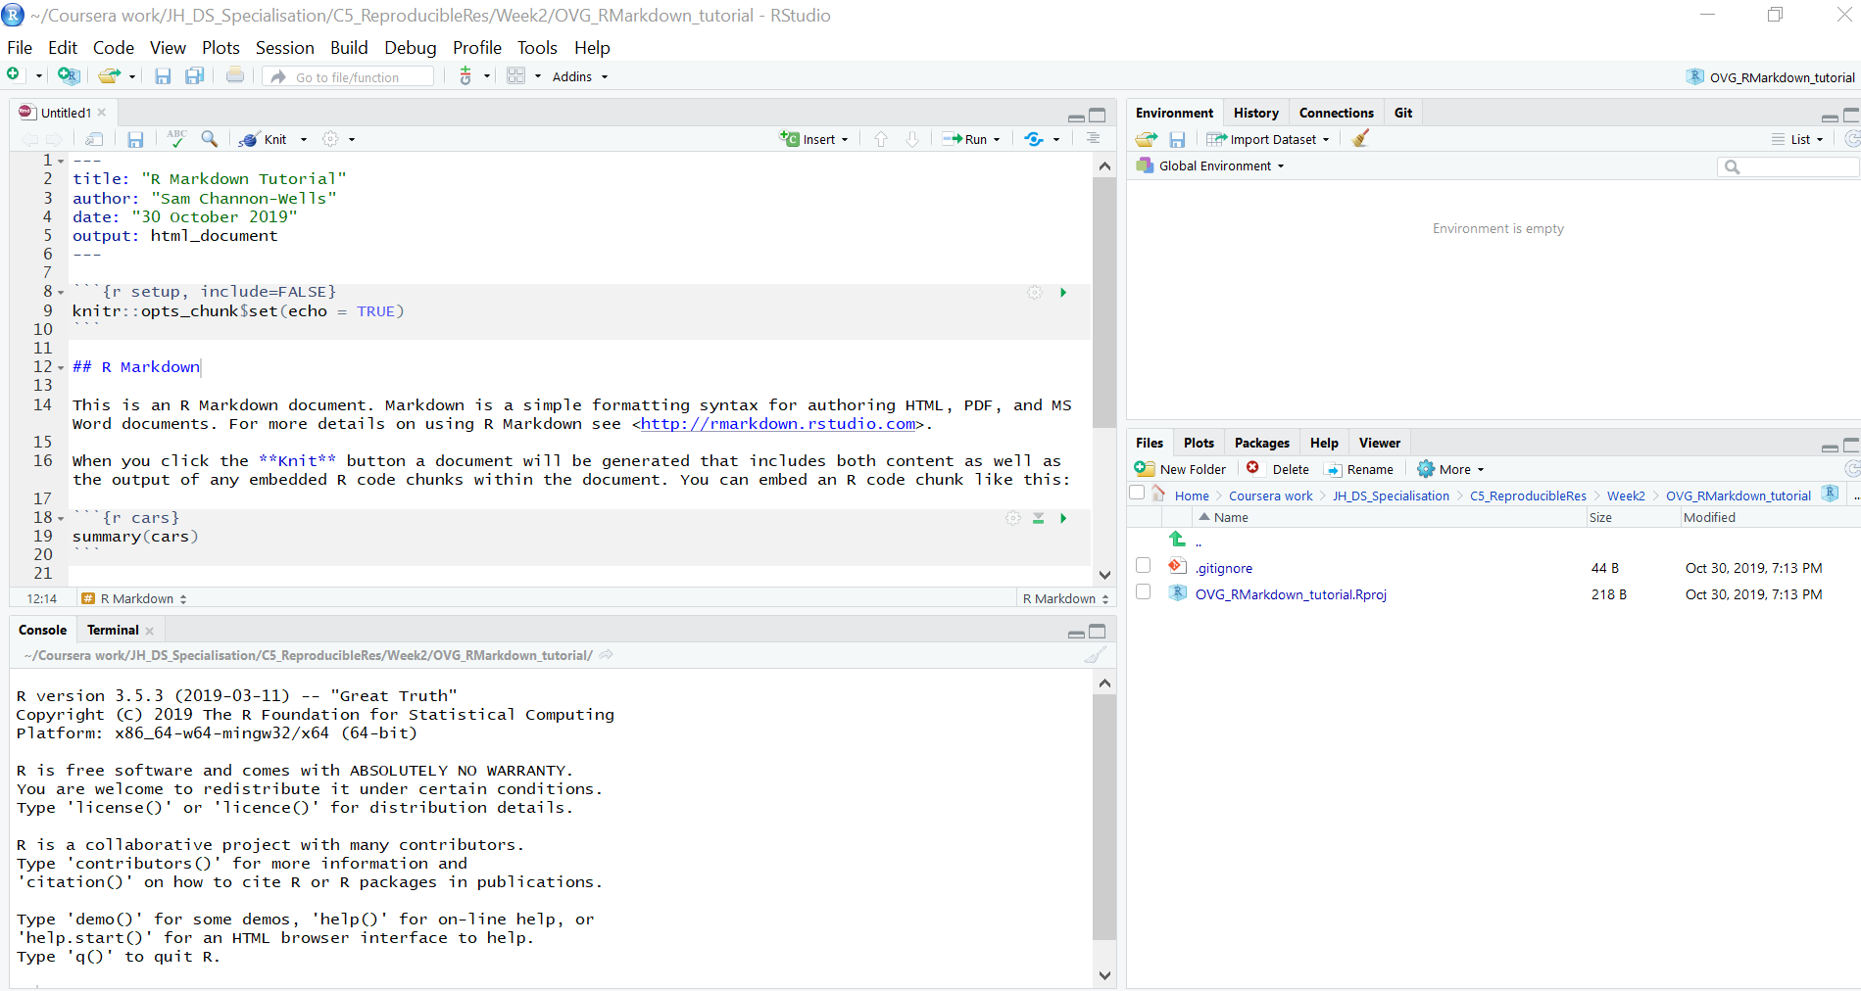
R Markdown - example
You will see this screen
Markdown document

Slide 13
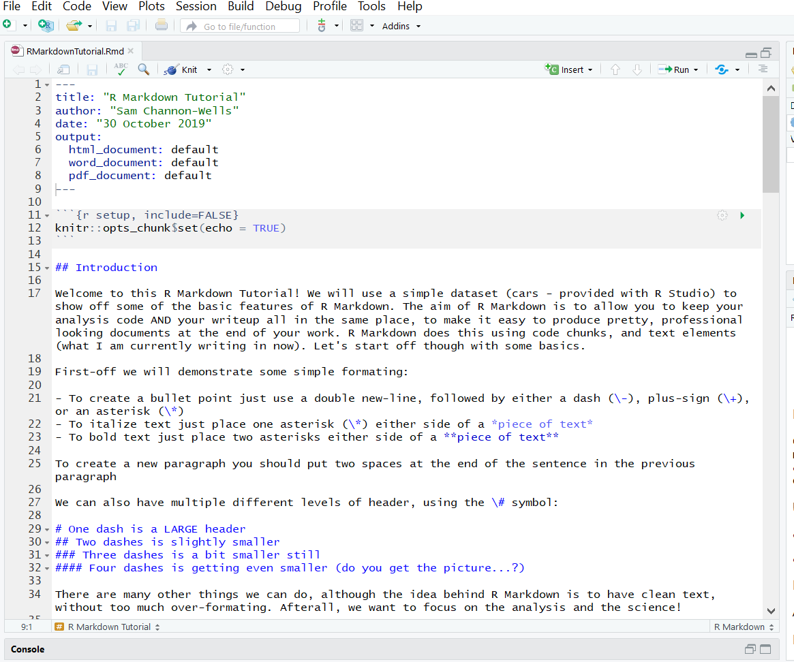
R Markdown - example
Set up options (don’t need to change)
Code chunk
Text element

Slide 14
R Markdown – code chunks
A code chunk is where you write your R code that will be run
Output from the code will appear in your final document
Each code chunk has:
Start of chunk
Chunk name
Chunk options
Code to be executed
End of chunk

Slide 15
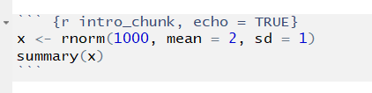
R Markdown – code chunks
Start of code chunk (three backticks)
Name of code chunk
Chunk options
Code to be executed
End of code chunk

Slide 16
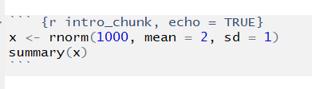
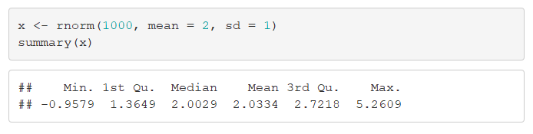
R Markdown – code chunks
R Markdown document
KNIT
Final html document

Slide 17
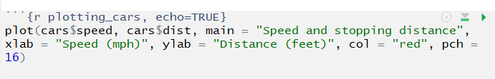
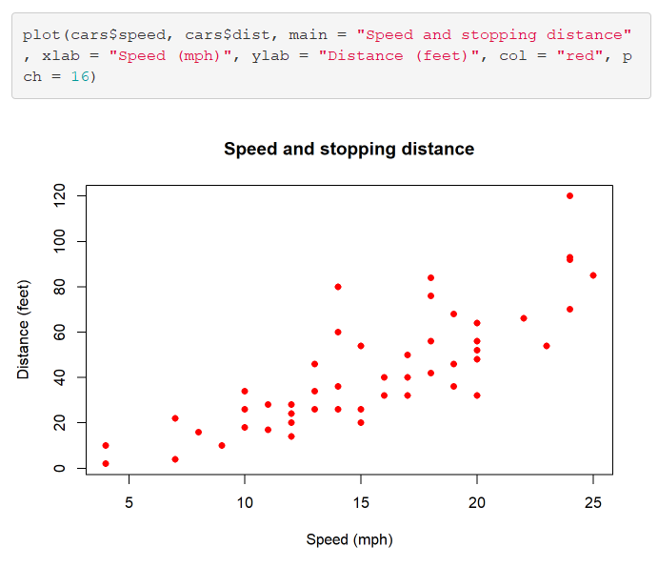
R Markdown – code chunks
KNIT
R Markdown document
Final html document

Slide 18
R Markdown – code chunks
Chunk options are placed in the start line of the code chunk
Chunk options allow you to change how the code chunk will be treated:
echo: set this equal to TRUE to print the code as well as the output of the code
include: set equal to FALSE if you don't want the code OR output of the code to appear in your document
eval: set equal to FALSE if you don't want the code to be evaluated (run) when knitting your document
warning: set equal to FALSE to NOT print warnings to your document when code is evaluated (use with caution!)
error: set equal to FALSE to NOT print error messages to your document (use with caution!)

Slide 19
R Markdown – code chunks
Chunk options

Slide 20
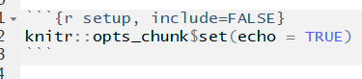
R Markdown – code chunks
We can set global options for all the chunks in our document in the very first code chunk:
Global chunk options
These global options can be over-ruled in subsequent chunks (but this will only apply for the specific chunk)

Slide 21
R Markdown – text elements
Text elements come between code chunks, and the text lets readers know what your analysis is doing
This is where you write your thoughts and ideas in response to the output of your code
When someone reads the final document they will then be able to see your thought processes

Slide 22
R Markdown – text elements
Text element

Slide 23
R Markdown – text elements
R Markdown uses simple formatting based on a language called Markdown (surprise!)
The aim is to make formatting simple, so as not to distract from the actual analysis and science
Some options are shown below
For more details checkout:
https://rstudio.com/wp-content/uploads/2015/02/rmarkdown-cheatsheet.pdf

Slide 24
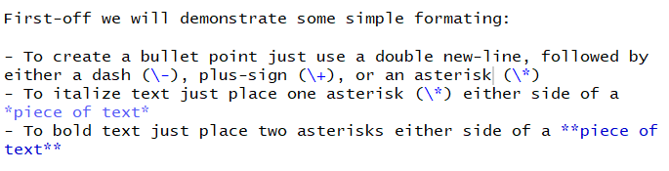
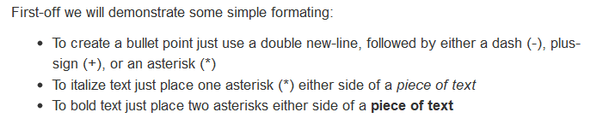
R Markdown – text elements
R Markdown document
KNIT
Final html document

Slide 25
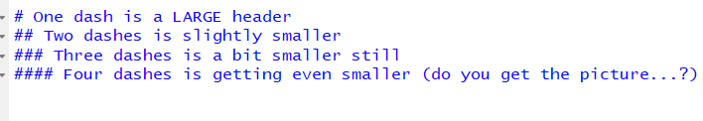
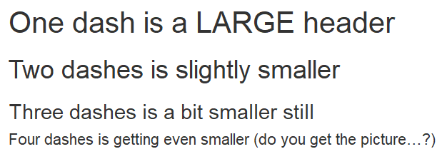
R Markdown – text elements
R Markdown document
KNIT
Final html document

Slide 26


R Markdown – text elements
R Markdown document
KNIT
Final html document

Slide 27
R Markdown – Knitting
Once you’ve completed your analysis you want to produce a professional looking document
To do this we use “Knitr”
This package fortunately comes fully installed and with a user interface in R-studio
If you open an R Markdown file you will see this

Slide 28
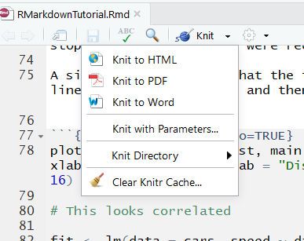
R Markdown – Knitting
Knit button, with dropdown options
Output options include html, PDF and Word document

Slide 29
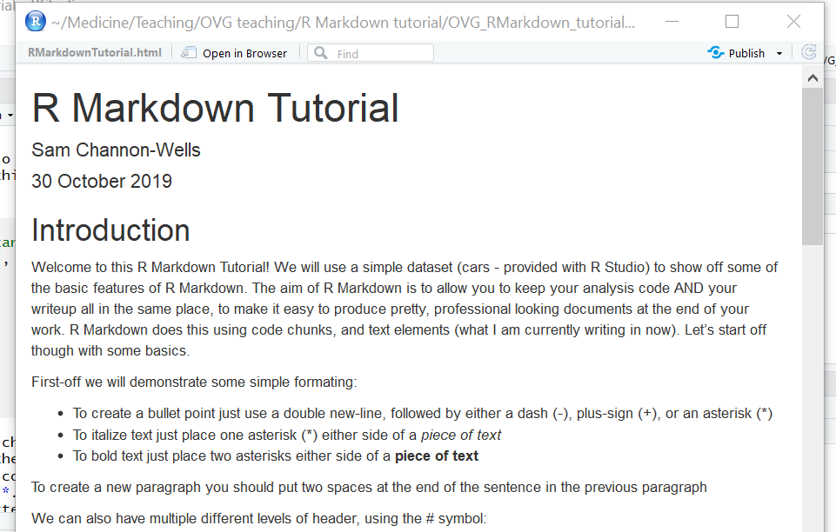
R Markdown – Knitting: html

Slide 30
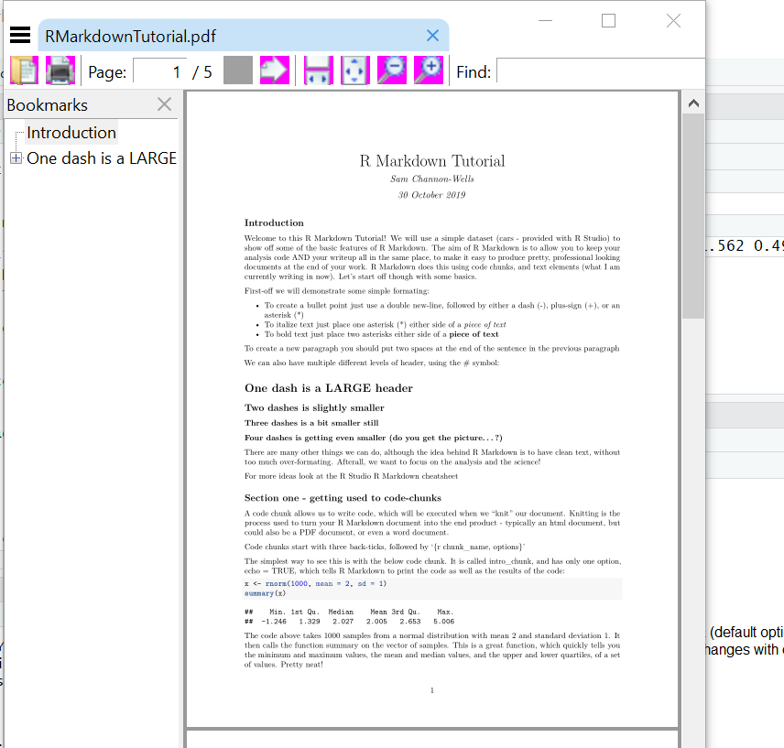
R Markdown – Knitting: PDF

Slide 31
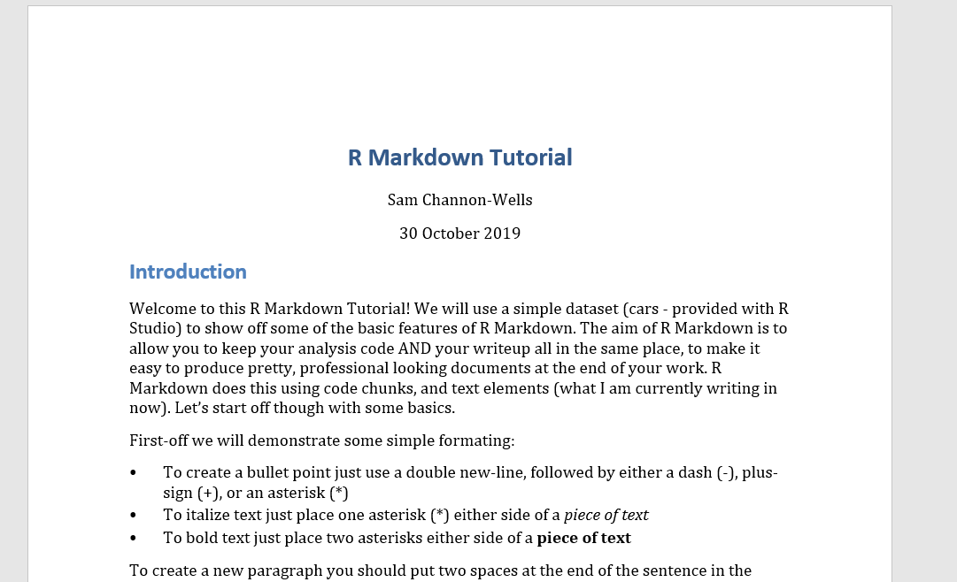
R Markdown – Knitting: Word

Slide 32
R Markdown – Knitting
Knitting a Markdown document (.Rmd) will generate a new file in your working directory (.pdf, .html, .docx)
These can then be shared with whoever you wish!
Whenever you update you R Markdown document you can just re-knit the document, which will update your html, pdf or word file

Slide 33
R Markdown – R Pubs
You can also publish these html documents very easily using R pubs, a free service!
Step 1 – go to rpubs.com
Step 2 – sign up for a free account
Step 3 – knit your document to html

Slide 34
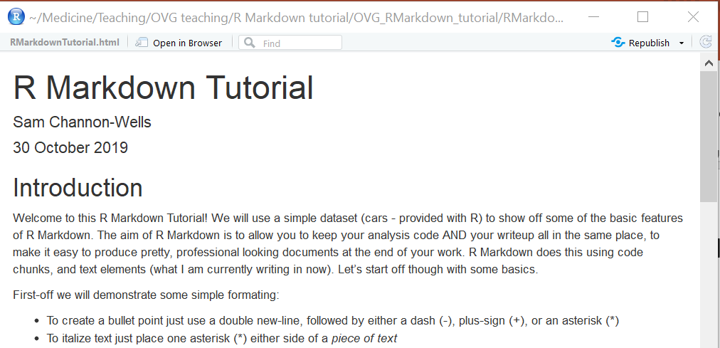
R Markdown – R Pubs
Step 4 – click on “publish” in top right (mine says republish as it’s already been published)

Slide 35
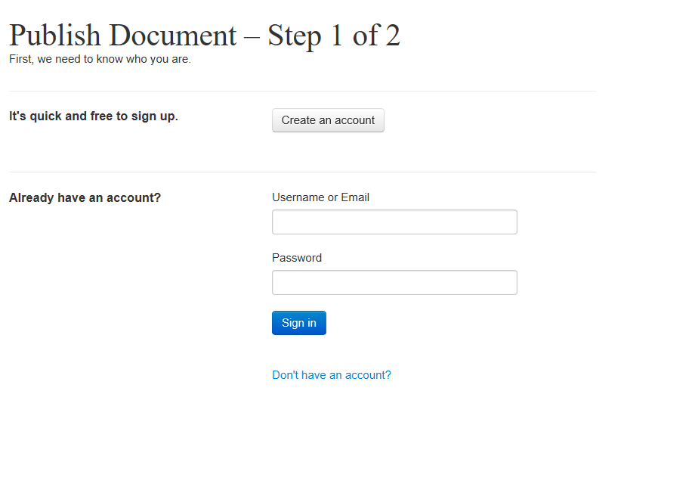
R Markdown – R Pubs
Step 5 – sign in to your R pubs account

Slide 36
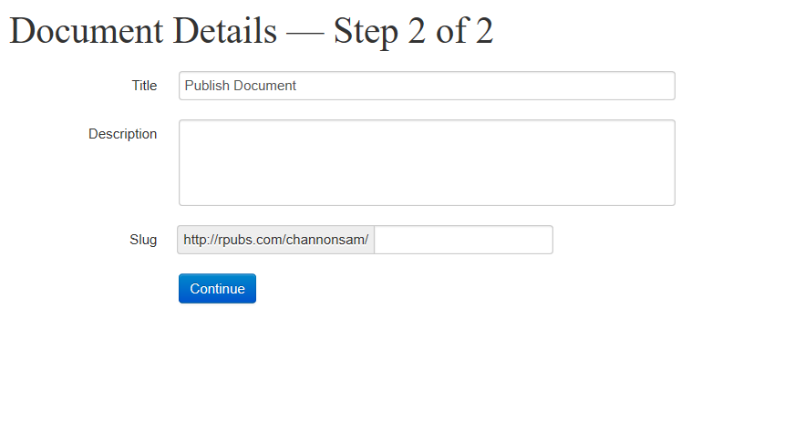
R Markdown – R Pubs
Step 6 – name and describe your document, and give it a url

Slide 37
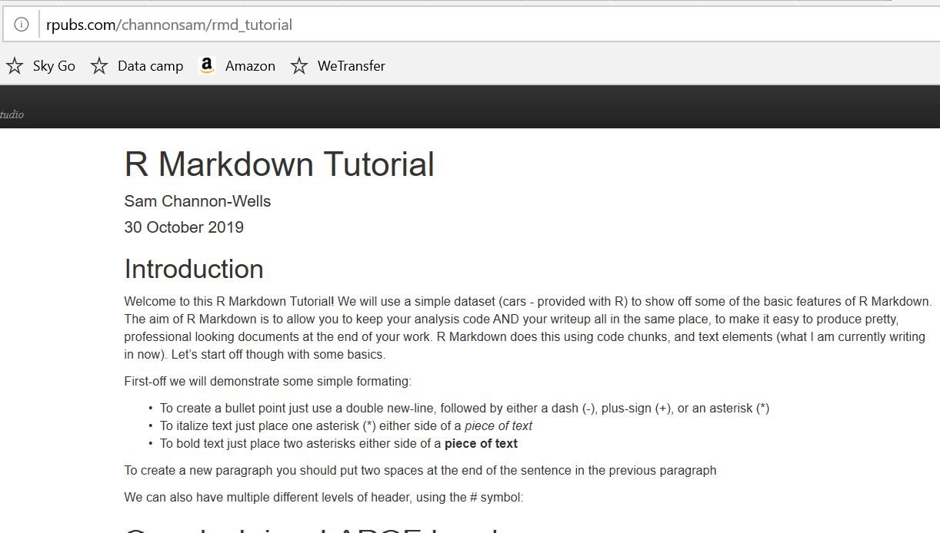
R Markdown – R Pubs
And you have published your document!
WARNING – anything published is immediately public
Share the URL to make sharing work even easier

Slide 38
R Markdown – R Pubs
You can find the html form of R Markdown document used in this tutorial on my Rpubs page:
https://rpubs.com/channonsam/rmd_tutorial

Slide 39
R Markdown – wrapping up
Thank you for listening/reading this
I hope this helps you communicate your great work, and structure your projects more easily
But we’re not finished there…

Slide 40
R Markdown – wrapping up
The best way to learn R Markdown is to use it
Follow the link below to my github repository where all the files for this tutorial can be found (including a copy of this presentation)
https://github.com/ChannonSam/OVG_RMarkdown_tutorial
Copy the RMarkdownTutorial.Rmd file to your own computer and experiment!!

Slide 41
R Markdown – wrapping up
If you have any comments or feedback on this tutorial email me at:
Samuel.channon@cantab.net

